Slide 1
© Your Name 2024

Slide 2
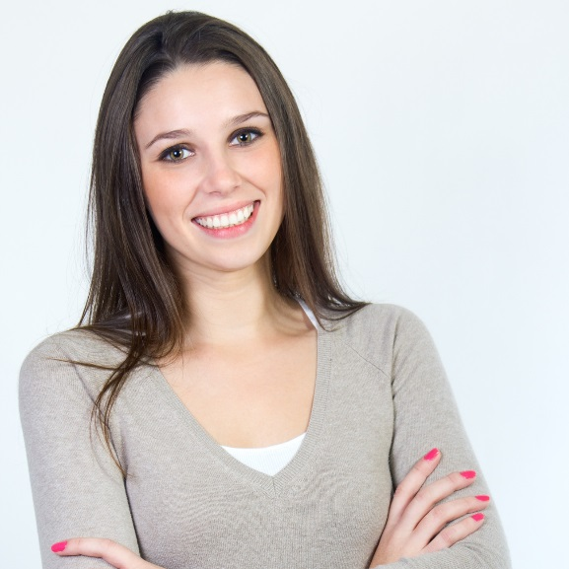
April Jones
Sample slide
complete slide 1 and delete
Assessment in Early Childhood Education
PhD, Final Year
Department of Early Childhood, Faculty of Education
1234-1234-1234-1234
@april_jones
© April Jones 2024

Slide 3
Create your presentation here.
You don’t need to use the same background colour on your slide(s). Make it your own.
If you have multiple slides, make sure you’ve set them to auto-advance and checked your timing.
If you’re inserting video or audio, make sure it is embedded and not linked to online locations. Your presentation must be able to play without an internet connection.
For tips and technical specifications, check the information in the competition kit.
Need inspiration? See previous finalists at: https://visualiseyourthesis.figshare.com/

Slide 4
REFERENCES
List your references for any resources you have used to create your entry.
Citations and copyright information for any media used, including images, audio and video files; and any software that you used to compile and create your entry.
Please note:
Your references/acknowledgements slides should use this template: you can delete this text and add your own.
You may use more than one slide if necessary.
The font size should be no less than 14 pt.
Each references/acknowledgements slide should be displayed for 5 seconds.
These slides will not count to the overall timing of your entry.
See the following slide for an example.
— Acknowledgments
Names of people, or groups, who helped with your project or entry.

Slide 5
EXAMPLE REFERENCES
Schoenmeyer, R. A., Menor, A. J., & Delaney, L. S. (2014). Is a Burrito a Sandwich? Probate and Property, 28(1), 5.
Brown, V, Wolfe, N,& Brook,B, News 2017, Adele wows Sydney but not without a few hiccups, News, viewed 15 September 2019, https://www.news.com.au/entertainment/music/tours/adele-wows-sydney-but-not-without-a-few-hiccups/news-story/c187de96891756ba2bf4d36bd4961ae5
— EXAMPLE Media Citations
Images:
Dog and cat icon Image# 965184 by b. farias from the Noun Project, 2017, licensed under Creative Commons, accessed 07 Aug 2019, https://thenounproject.com/term/dog-and-cat/965184/
Photo “Child on Swing” taken by Maeve Farrell, provided by and property of Child Protection Victoria. Written permission acquired.
Music:
A Small Miracle by Romarecord1973 (2023), accessed via Pixabay.com, https://pixabay.com/music/acoustic-group-a-small-miracle-132333/
Sample slide
complete reference slides and delete

Slide 6
EXAMPLE Media Citations
Other:
Animation and all other graphics created with PowerPoint Microsoft Office, licensed under paid subscription.
Video edited with Canva, accessed under a free subscription; and Adobe Premiere Pro, accessed under an institutional subscription to Adobe Creative Cloud.
Animated video excerpt courtesy of the Climate Society Institute from the “Coral Reef Exploration in VR” research project – Commodore C. Smith, Petty Officer J.S. Miller and Emeritus Professor J. Wang. — EXAMPLE Acknowledgments
Thank you to my supervisors, Prof. Juliette Mercer and Dr Vladimir Marks, for their feedback and support, and my lab colleagues Al E. Gator, Reece Donaldson, and Fatima Amed.
Sample slide
complete reference slides and delete

