Slide 1

Establishing the Context:
Social Impact Assessment for
Disaster Recovery Planning
Dr Yetta Gurtner
Orchid ID : orcid.org/0000-0002-7830-6718
Notes:
Exploring the utility of Social Impact Assessment as a framework to identify community vulnerabilities, capacities and needs for effective disaster recovery.

Slide 2
Overview
Disaster management and recovery
Project/research rationale
Parallels between disaster recovery and SIA objectives
The framework/process
Challenges

Slide 3
Disaster Management
Mitigation/Risk Reduction/Prevention
Preparedness/Readiness
Response
Recovery
Ideally proactive
Notes:
Continuous, iterative rather than linear
All Hazards, all phases, all resources, all stakeholders
Disaster as a catalyst for change – rather than return to normal – build back better
Ideally proactive – however by necessity element reactive response and recovery
Lessons learnt

Slide 4
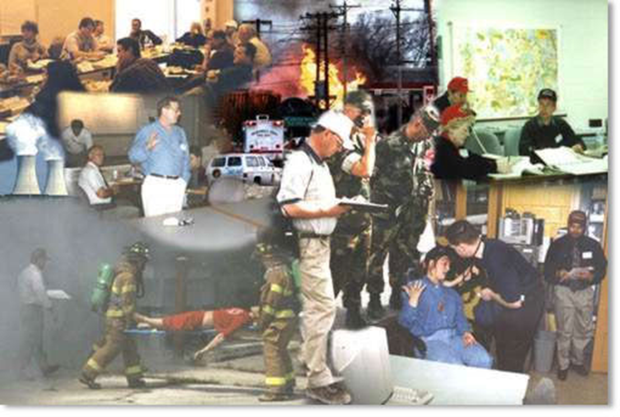
Notes:
Emergency management is reactive and temporal – response
Know context –
Geography, demography, key community characteristics, recognised hazards/risks, historical risk context, local authority/governance, logistical issues, organisational structures, priority concerns

Slide 5
Rationale
Effective community/local assessment “post-disaster”
Informed decision making for sustainable redevelopment
“Build back better, stronger and safer”
Notes:
Cyclone Larry – Cat 4 Innisfail 20 March 2006 – wind gusts 240km/hr over $1 billion damage – 1 fatality – direct damage to buildings, dwellings, rain, storm surge – ECONOMIC (industry) PYSCHOSOCIAL

Slide 6
Community Disaster Recovery
Limit losses
Reduce suffering
Restore psycho-social and economic viability of the community
Sustainable redevelopment
Disaster Risk Reduction
Notes:
UNCEERTAINTY AND RAPID CHANGE – FLEXIBLE AND ANTIPATE
Provision of timely information
Minimising the escalation of the consequences of the disaster Primary: direct, measurable losses (loss of a house or a crop) fatalities
Secondary: indirect losses incurred (e.g. someone being out of business for a while)homelessness
Intangible losses – risk perception, fear, grief,
Tertiary: Flow losses or negative impacts due to shifts in the macro economy to respond to the disaster. loss of social cohesion
Rehabilitating the emotional, social and physical well-being of individuals within communities – BOTTOM UP RATHER THAN TECHNOCRATIC TOP DOWN
Taking opportunities to adapt to meet the physical, environmental, economic and psychosocial future needs
Reducing future exposure to hazards and their associated risks.

Slide 7
Social Impact Assessment
The systematic analysis in advance of development or policy changes that will bring social change to a community
Development of community resilience;
A social justice approach;
Anticipating consequences;
Better informed decisions;
Maximising opportunities; and
Minimizing negative outcomes
Notes:
For effective informed decision making it is necessary to systematic information/data

Slide 8
SIA Process
Identify potential change/impacts
Measure baseline data
Examine social implications
Actions
Communicate changes
Enhance positive and mitigate negative impacts
Monitor and evaluate
Notes:
SIAs provide a systematic framework to:
Anticipate social change from a project or policy change
Measure baseline data and project impacts
Look at the potential social implications
Communicate changes to the community
Outline steps to mitigate or enhance negative or positive aspects of change
See that the benefits of change do not empower some groups over others
Description of proposed actions
Relationship of the proposed action to land use plans
Probable impacts on the ecology
Alternative to proposes actions
Identifying unavoidable adverse effects
Local short term impacts and long-term issues
Identifying irreversible and irretrievable impacts
Other considerations such as psychological impacts

Slide 9
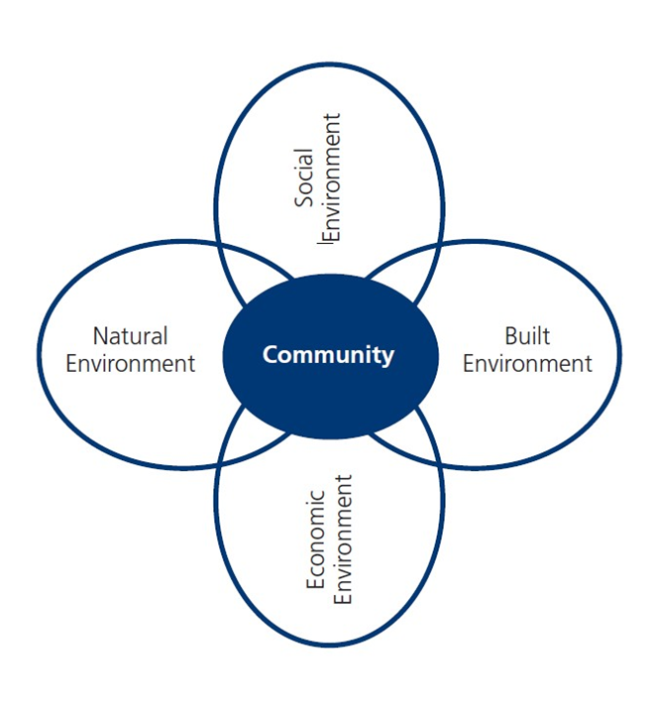
Scoping
Identify potential impacts/change
Direct/indirect,
Tangible/intangible
Notes:
Disaster damage and loss assessments must be credible, meaningful and holistic to secure the commitment and resources of governments and civil society in the disaster recovery phase, and importantly, to build community and business resilience and reduce the risk of potential disasters in the affected area and throughout the wider economy.
APEC economies should work towards harmonising damage and loss assessment techniques in the region to allow the compilation of credible region-wide data to help build regional support and consensus for disaster risk reduction policies and initiatives, and to ensure region-wide resilience.
Economic damage assessments should be consistent and transparent, and based on primarily economic principles and robust evidence.
The damage, loss and needs assessment processes should be integrated, and prioritized, address all hazards, and accommodate the need for, and different objectives of, a rapid assessment, early recovery assessment and an in-depth assessment for longer-term rehabilitation, reconstruction and recovery.
To be comprehensive, in addition to direct damage and indirect losses, the damage and loss assessment methodology should allow for an estimation of macro-economic impacts (eg. national income, government debt, trade deficit, development prospects) and, to the greatest extent possible, intangible impacts (eg. social, psychological, environmental, loss of life).
The human dimensions of disaster should be a key consideration in damage and loss assessment, including the impact on vulnerable groups.
When assessing needs, the longer-term recovery phase should be viewed as an opportunity to boost and accelerate development and economic growth, and to mainstream disaster risk reduction initiatives – to build communities with greater prosperity, resilience and preparedness than
before the disaster.
Assessors and planners should look beyond short-term emergency needs and consider broader long-term needs for sustainable development, including climate change adaptation needs.
9
Disaster damage and loss assessment should be coordinated by one government agency,
involve multi stakeholders, and include relevant government agencies from appropriate levels,
be that local, regional or national.
10
Local community stakeholders must be involved and surveyed in every stage of the process to
ensure a realistic picture of damage, loss and reconstruction and rehabilitation needs, as well
as to identify the capacity of the affected community.
11
To be meaningful, damage and loss assessments must have relevance and applicability to the
jurisdiction of the decision-makers – whether national, sub-national or local – and whether public,
private or civil secto
Sociological systems approach – individual etc
Reflects interconnection of human actions and environmental impact – no right or wrong approach
Holism advocates a multi/interdisciplinary perspective – awareness, appreciation, understanding
Ecological/linkages approach – holism – stakeholders and common interests
Understand established history, cause, conditions and culture of disaster and any management approaches
Development and disasters
Increased economic and technological interdependence
Common casual factors
Poverty
Population growth
Rapid urbanisation
Transition in cultural practices
Environmental degradation
Lack of awareness and information
War and civil strife
Communities have wide and varying range of needs
Understanding/recognition vulnerabilities and capacities – indicators – quantitative/qualitative - intangible

Slide 10
Establish the Context
Data collection (baseline variables)
- Determine event/hazard context
- Establish local community data
- Identify key stakeholders
- Identify existing resources and capacity
- Rapid appraisal – damage and loss
- Basic needs assessment/priorities
Notes:
– scope, size, dimensions, duration – historical data on hazard exposure
Local/resident knowledge/existing groups – engaging marginalised, minorities vulnerable (mixed methods)
Provision of timely information
Community (individuals, families, households, communities)
Historical and cultural context
Government – local, state, commonwealth
Emergency service/management providers
Public and private organisations
Local knowledge
Risk/Hazard Profiling
Identifying
- Vulnerabilities
Capacity
Resources

Slide 11
Community Variables
Psycho-social
Economic
Infrastructure
Environment
Notes:
No exhaustive
Social, built and natural environment
Direct damage and indirect loss – intangible loss/benefits

Slide 12
Social/Psychosocial
Safety and wellbeing
Vulnerable/marginalised groups
Health – physical and mental
Demographic change
Human resources/skills
Culture/values
Governance/networks
Notes:
Psycho-social – need of a communities functions, social structures and systems – formal and informal networks
Safety and Well being – Hazardous or damaged areas/buildings, sanitation and hygiene, shelter, accommodation, evacuation, medical
Health – case management of individuals, injured, exposed, traumatised, recognise vulnerable/special needs groups, resources and supplies
Welfare/psychological support – emotional, spiritual, cultural, psychological, social support – conselling, financial assistance, sports and leisure, community events…
Demography
Education
Mental/social health
Public housing
Families and households
Networks and relationships/trust

Slide 13

Notes:
Source of information:
Maps/remote sensing data
Strategic data
- ABS statistics
- Local Social Atlas
- agency databases
Media
Interpersonal communication
Department of Health
- Nursing Mothers Association
- Community Health Clinic
Medical service providers
Centrelink
Family Assistance Office
Department of Housing
Accommodation service providers
Property developers
Real estate agents
Insurance Council Australia
Education
Yellow pages
Business Service Directory
Local Council
Chamber of Commerce
Department of Primary Industry
Religious/cultural organisations

Slide 14
Economic
Individuals
Employment
Livelihoods
Businesses
Economic sectors
Resources – savings, investments, insurance
Government
Notes:
Stabilisation
Individual needs – supply and demand – livelihoods, employment security, income - salary and wages, debt servicing, savings, insurance – purchasing and general consumption
Infrastructure - basic utilities, telecommunications, transport
Government (macro) – maintain support, resources, overseas markets
Business –(SME) trade, staffing/labour force , consumer confidence, local industry/economic production
Finance sector

Slide 15
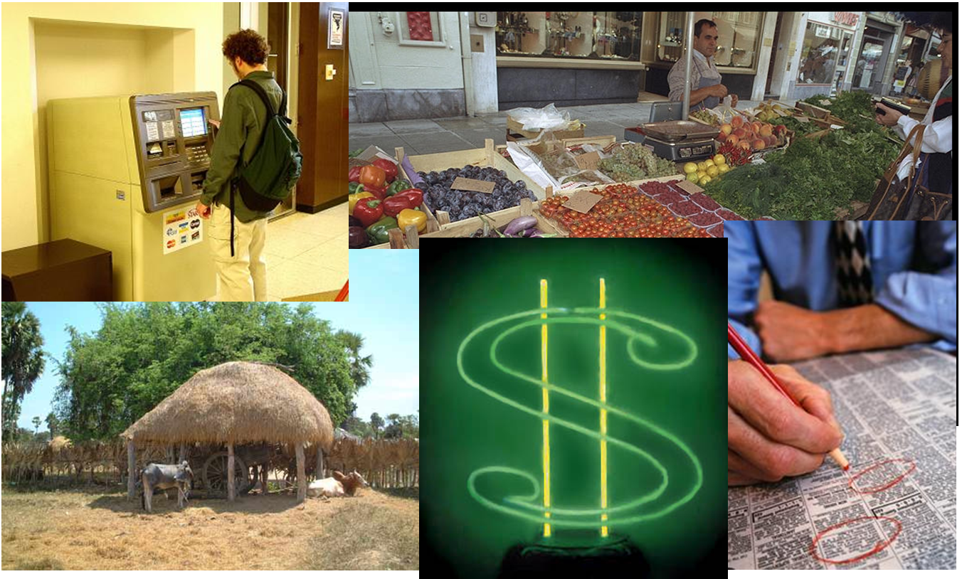
Notes:
Source of information:
ABS
Centrelink
FAO
Department of Housing
ATO
ABS
DPI
Chamber of Commerce

Slide 16
Built Environment
Residential – shelter/housing
Rural assets
Lifeline Utilities – water, sewage, electricity
Infrastructure
Transport networks
Commercial/Industrial
Public building and assets
Notes:
Planning, development (construction and design) insurance - Repair, reconstruction, relocation, retrofit, renovate, adaptation (codes and standards) structural engineering solutions
Residential – compliance, maintenance, assessment and repair
Rural – continuity/sustainability
Lifeline utilities – essential services(logistics) – transport, communications, drainage – long term strategies – urban planning, management, MOUs, construction
Commercial/Industrial – business continuity – maintain, revive, restore – economic viability
Public building assets – identify/prioritize critical buildings and facilities – social value (landmarks, significant/ symbolic community sites) administration

Slide 17
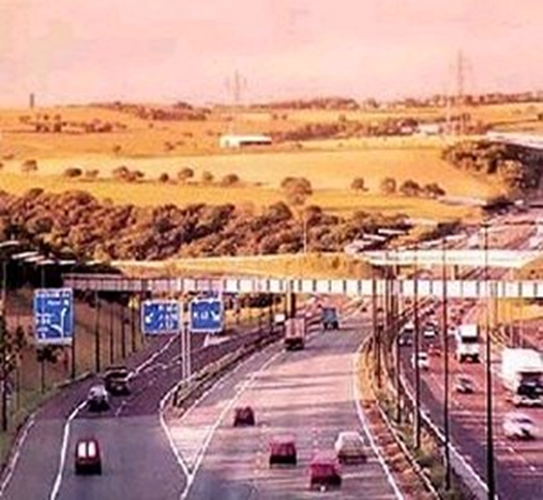
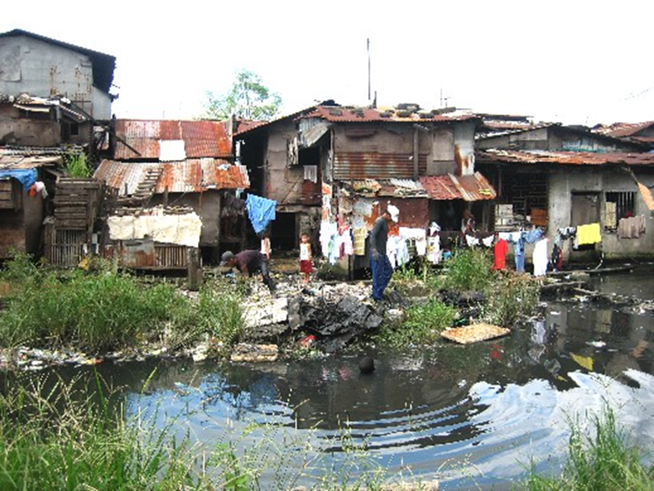
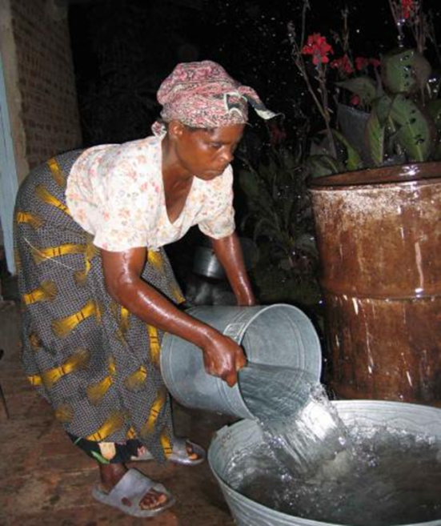


Notes:
Source of Information:
Public works departments and transport ministries
Public utilities:
Ergon
Elgas
Telstra/Optus
Port authorities
Surveying departments
Engineering regulatory institutions
Contractors
Water and sewerage agencies
Maps

Slide 18
Natural Environment
Biodiversity and ecosystems
Amenities value
Waste/pollution
Natural resources
Land-use
Geo-physical change
Debris management
Notes:
Biodiversity and ecosystems – flora and fauna, habitats, threatened species identification, protected areas, sensitive environments
Amenities values – recreational, social or cultural importance (instinsic value)
Waste/pollution – management and disposal, environmental quality hazardous materials
Natural resources – economic value of environment – productive land, water sources etc
Topography, hydrology
management

Slide 19
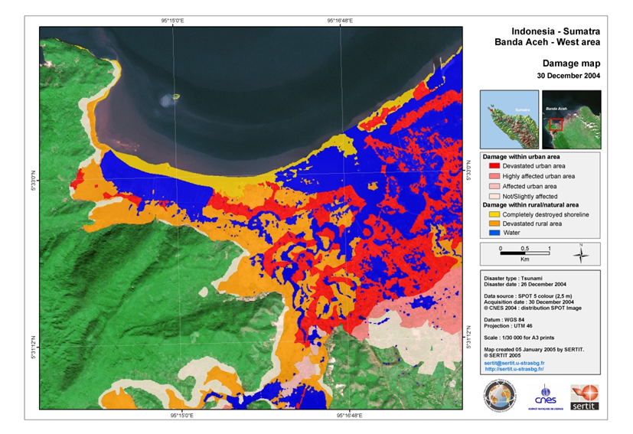
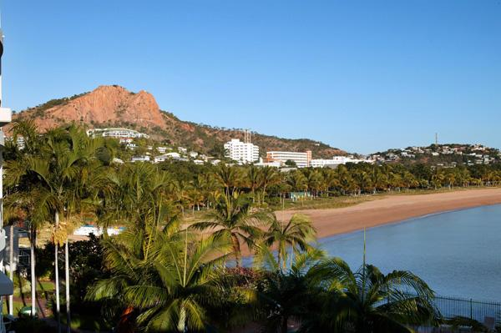
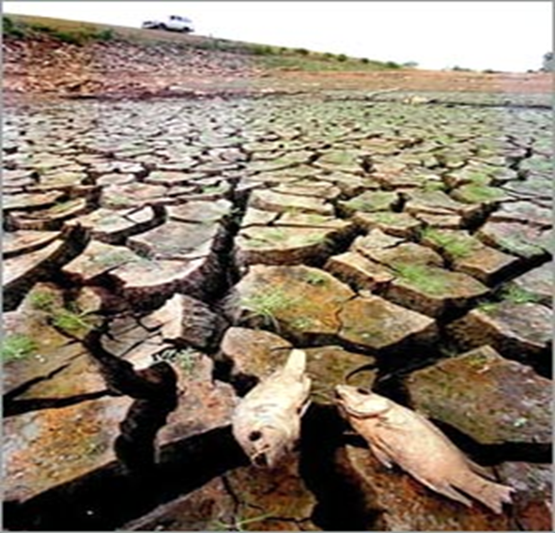

Notes:
EPA
Research institutions
Geographic information systems
On - site, aerial or satellite photographs or films, relief

Slide 20
Immediate Actions
Identify immediate needs for services
Access available services and resources
Coordinate recovery resources and services
Support service providers
Interventions

Slide 21
Communication and change
Needs
Priorities
Opportunities
Public support/participation
Planning
Policy
Decision making – protect, accommodate, retreat
Notes:
Liason, credibility, advocacy
Protect, Accommodate or Retreat

Slide 22
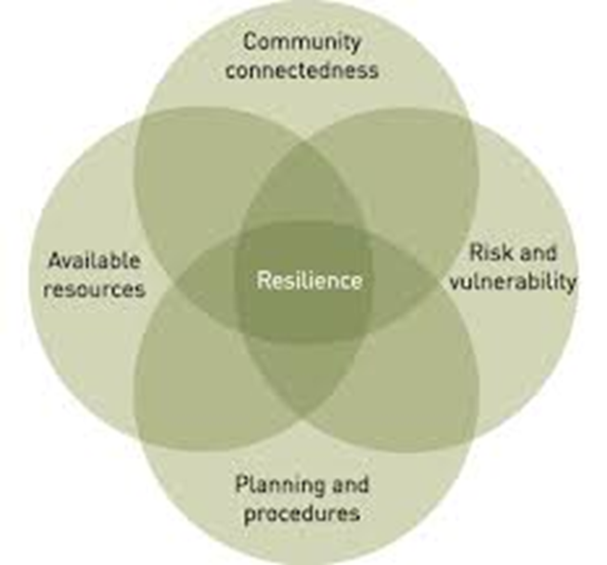
Capacity building
Community/stakeholder engagement
Integration and partnerships
Resilience
Adaptive capacity
Resources
Commitment
Notes:
ENHANCE POSITIVES AND MINIMISE NEGATIVES
Networks and relationships
Climate change adapation

Slide 23
Sustainable Redevelopment
Monitor
Review
Evaluate
Educate and adapt
Disaster Risk Reduction
Notes:
Iterative process

Slide 24

Challenges
Context dependant
Credible/timely information
Effective communication
Flexibility/adaptable
Ethics
Transparency/accountability
Uncertainty
Notes:
Experienced/trained/dedicated practioners/staff, not a recipe, mulit disciplinary/respect for other practioners
Flexible /adaptable – context dependant
Apathy and complacency – vs lessons learnt

Slide 25

Notes:
“while the development of urbanised and industrialised systems becomes increasingly more complex and interconnected, the quantity, scale and adverse effects of disasters are only likely to continue to grow”

Slide 26


Questions?

