Slide 1


Job of the Week
Slide ideas for lecturers
Increase awareness of the job market and skills
Provide ideas for career planning
JCU Careers and Employability

Slide 2

How?
Find a job vacancy
Highlight interesting points - a single slide will do
Share in lectures, tutorials, subject sites

Slide 3
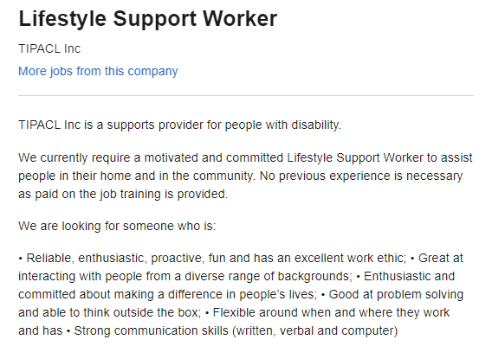
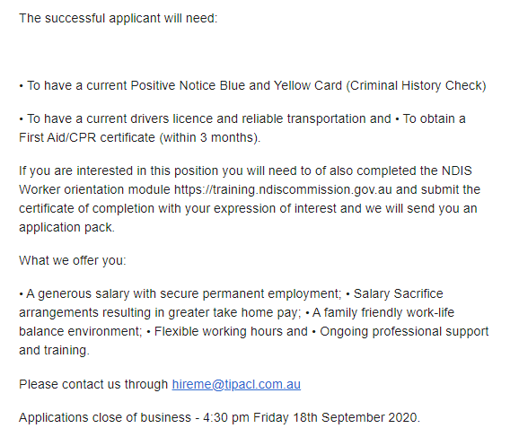

No experience necessary – perfect for students to increase theirs
Jobs that develop transferrable skills build employability – highly sought after by all employers
Show common licenses and certifications – help students plan
Tip
Entry level jobs show first steps
– they might be able to apply as a student
– they show a realistic first job to get experience

Slide 4
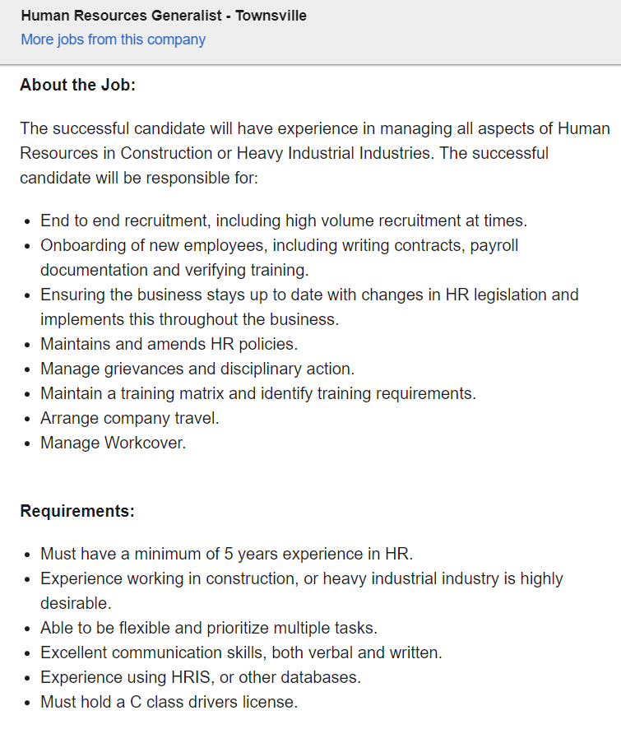

Lists of tasks and processes give lots of industry insight
Improve awareness of job scope
Pre-plan placements - what common tasks do you want to get experience in?
Use the terms as tags on PebblePad reflections - easily find examples for job applications
Tip
Bring understanding of how long it might take to achieve certain roles
Aspirational jobs
guide career planning
identify skills and experience
sought by employers
seek out ways to
build this experience
Other useful skills, hard and soft

Slide 5




Tip
Show a job search platform
Display a range of employers
for students to research
Assist generalist degrees
identify industries of interest,
rather than specific jobs

Slide 6

Share where you found it, especially if it’s a niche platform
Tip
Link jobs to teaching
Find a job that’s
specific to a topic or skill
to make explicit links
to your subject content.
Jobs with different
job titles or roles
broaden search terms and increase opportunity awareness.

Slide 7
Tip
Promote the Employability Edge Graduate Job Search module
Encourage students to self-help and get more info through JCU Careers and Employability’s online module
https://www.jcucareers.info/edge/module/graduate-job-search/

