Slide 1

Simple ways to hear from
employers and alumni
JCU Careers and Employability
Alternatives to in-class guest speakers
Ideas and powerpoint templates

Slide 2
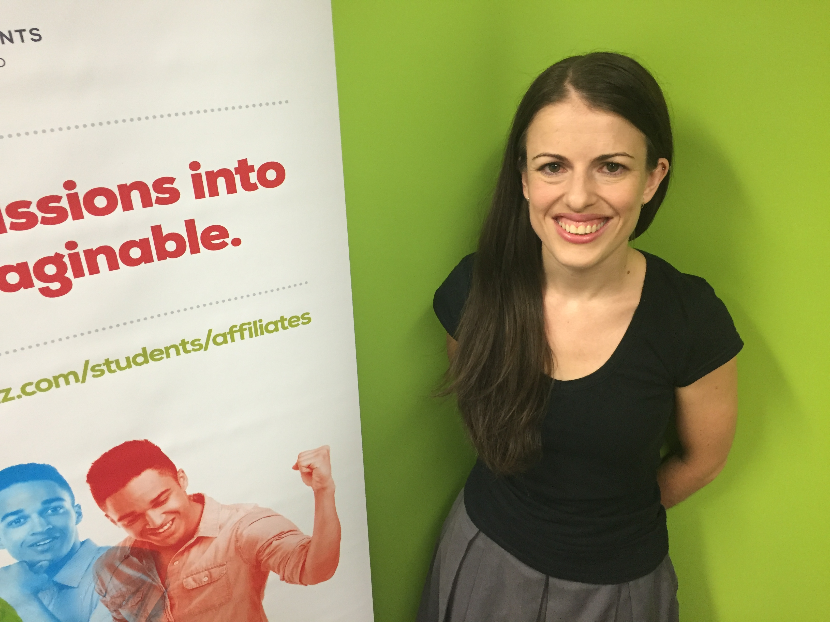
“Being part of a professional association helped me meet experienced accountants, which was great for my understanding of what the job really looked like day to day. Being able to have those conversations, even just the social ones, was really good for my confidence as well.”
You can use many pieces of information from one source to highlight different points.
Consider emailing through
a series of questions
that you can break up
and intersperse throughout the semester.
If they can supply several photos this will help to keep the look fresh, but one will suffice.
These slides are all
one image and
one text box so
it is easy to create.
Carol Smith, Student Representative, Chartered Accountants

Slide 3

“If there’s one piece of advice I have, it’s that
I wish I’d paid more attention in GIS classes because it’s something
I use every day at work.”
Jenny Smith, Environmental Officer
A simple statement like this (an actual quote from an industry panel) can reinforce the importance of a particular subject or skill, or ‘advice I’d give my younger self’.

Slide 4
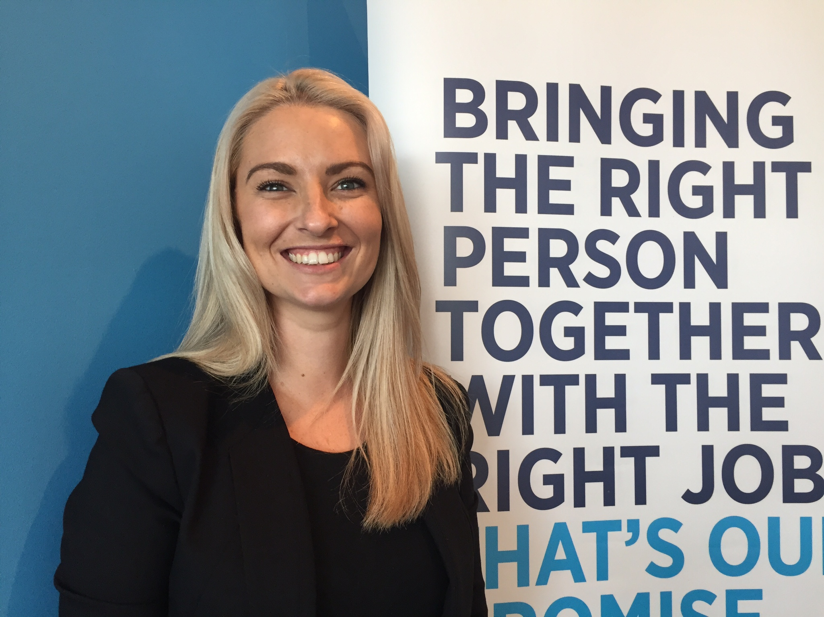
“Students that have engaged in activities external to their course that relate to the industry they are targeting are more attractive to employers.
Things like volunteering, work experience they’ve sought out themselves, those things make them easier to place. They’re valuable for a lot of reasons but a good one is that they’ll have a reference from that industry.”
Recruitment agencies offer valuable insights into current hiring practices and what’s valuable to an industry, rather than one company only.
Sarah Purdue, Hays Recruitment

Slide 5
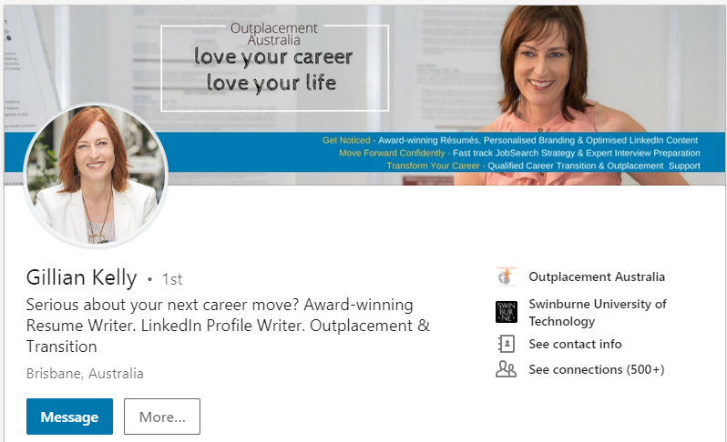
LinkedIn posts and features are great sources of info as well.
Keep in mind, Australian sources are better when commenting on Australian recruitment practices as these are different in every country.
“When it comes to rants, what seems to be peeving recruiters the most currently, is applicants who respond to job posts that clearly say 'email your resume' with a comment 'see my profile‘…
Take home message: It seems if you want the job show you can follow instructions”
https://www.linkedin.com/pulse/surprising-tips-ive-heard-recently-from-recruiters-other-kelly/

