Slide 1


Celebrating Sessional Staff at JCU
2017 Sessional Teaching Award Ceremony

Slide 2
I acknowledge the Australian Aboriginal and Torres Strait Islander peoples as the first inhabitants of this country and pay my respects to the Traditional Owners and Elders, past and present, of the land on which we stand today, the Irikanji, Tpakukai, Gumuy Yidinji, Bindal and Wulgurukaba peoples.
In the spirit of reconciliation, I also acknowledge the valuable contribution that Australian Aboriginal and Torres Strait Islander peoples continue to make to James Cook University and the broader community.
Notes:
Acknowledgement of country

Slide 3

Professor Chris Cocklin
Senior Deputy Vice Chancellor
James Cook University

Slide 4
Dr Kay Eccleshare
Adjunct Senior Lecturer,
College of Public Health, Medical & Vet Sciences

Slide 5
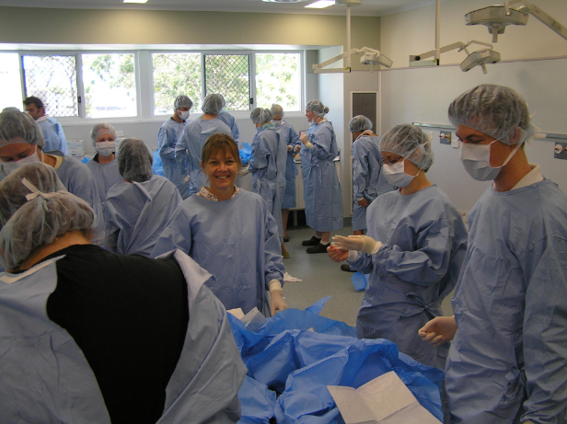
Who am I……..?
What do I do……?
Adjunct lecturer
College of Public Health, Medical and Veterinary Sciences,
Senior Veterinarian
Tableland Veterinary Service
Dr Kay Eccleshare BVSc, MANZCVS (SA Surgery),GCertTertEd

Slide 6

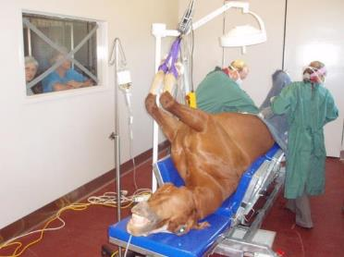
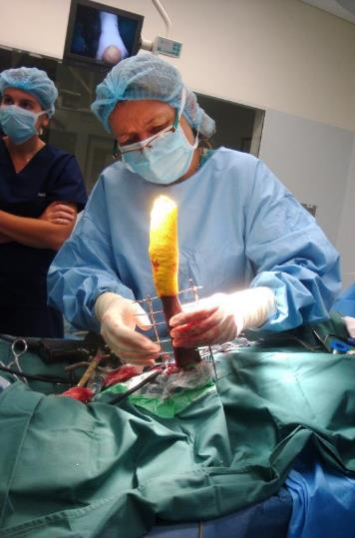
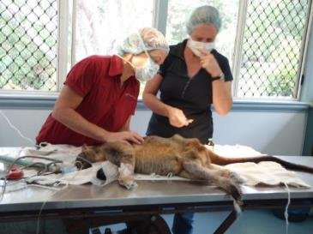
At the start of the week….
Clinical work
on the
Tablelands

Slide 7
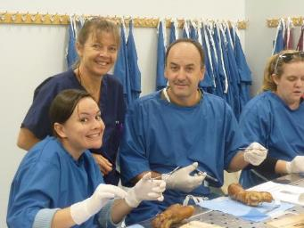
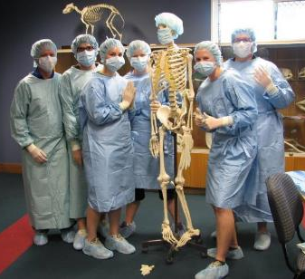
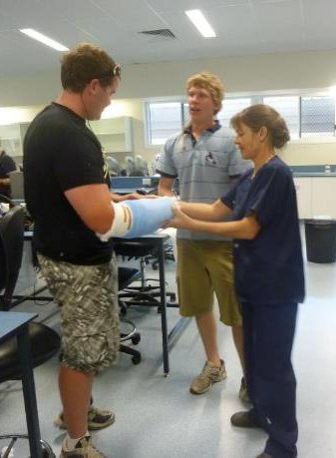

….and at the end of the week ..teaching surgical skills to Veterinary Students

Slide 8
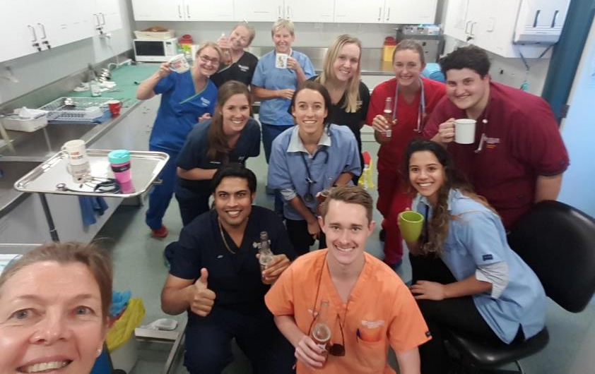
Why was I nominated for the sessional staff teaching award……..?

Slide 9
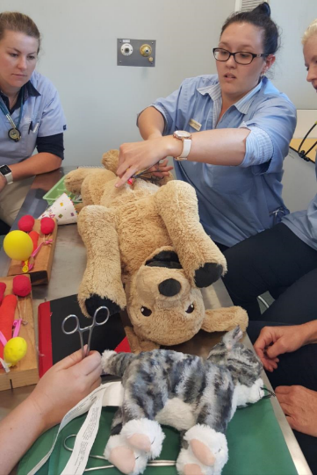
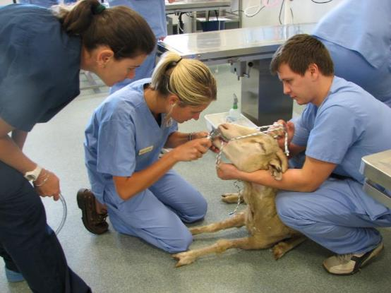
Internationally there is pressure to reduce the use of live animals in veterinary education.
Leading to changes in curricula design, assessment methods and the development of models for surgical skills training.

Slide 10
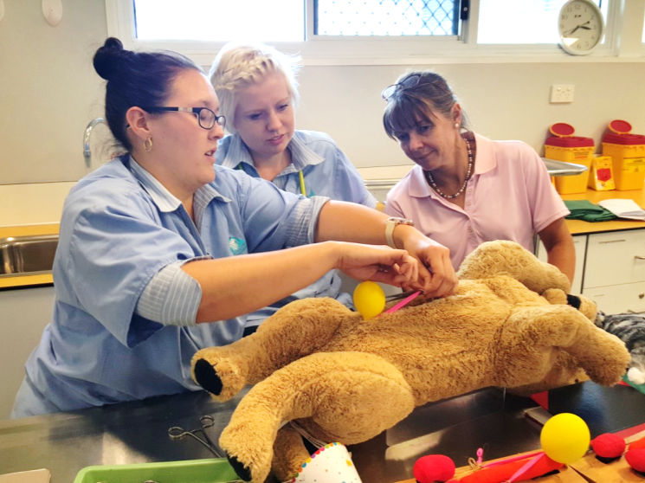
…… we need to train a student from here……

Slide 11
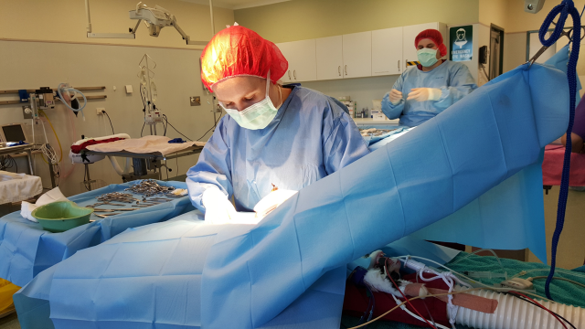
….to here – recovery refuge cat speys …….in 23 hours

Slide 12

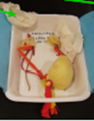
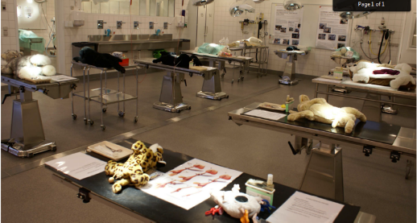
From where did we source information to inspire the surgical skills program….?
Conference attendance
Literature review
Feed back from students
Peer/mentor feedback and suggestions
Personal ideas

Slide 13
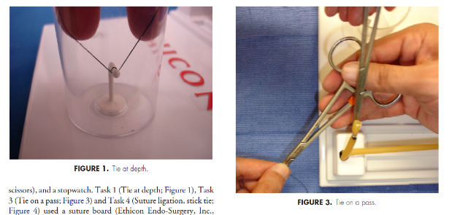
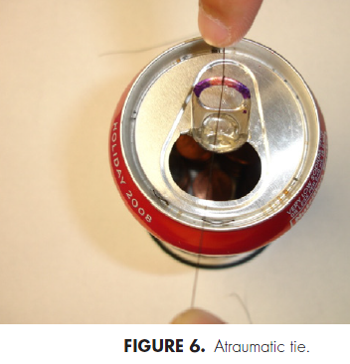
Literature review
Mashaud, L.B., et al., Development, Validation, and Implementation of a Cost-Effective Intermediate-Level Proficiency-Based Knot-Tying and Suturing Curriculum for Surgery Residents. Journal of Surgical Education, 2013. 70(2): p. 193-199.

Slide 14
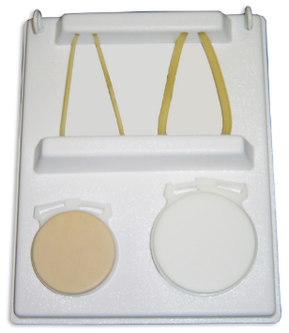
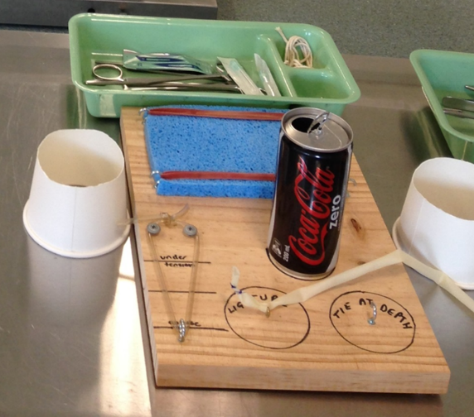


Slide 15
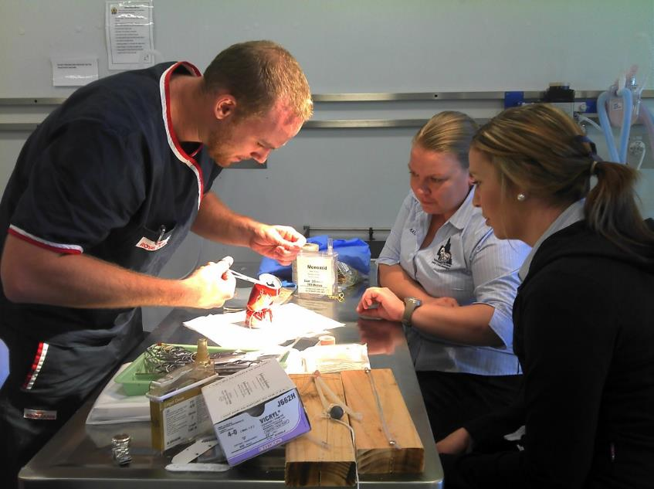
Results of the EDUCAUSE ECAR survey
Notes:
The ECAR Survey (EdUCAUS Center for Applied Research) has been used to find how students really do relate to technology. Both the Australian and Malaysian projects will use an adaptation of the ECAR survey to monitor our progress and success

Slide 16
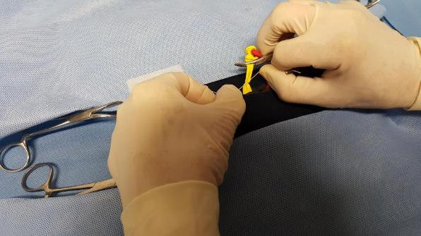
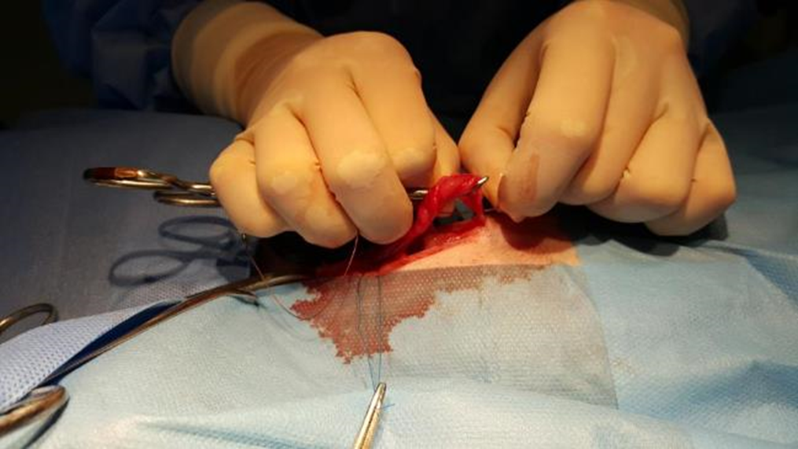

Personal ideas
Ligation model developed using balloons inserted under tension through and incision in a Stubby cooler
Ligation of an ovarian pedicle in a recovery cat spey – the students first live tissue surgery

Slide 17

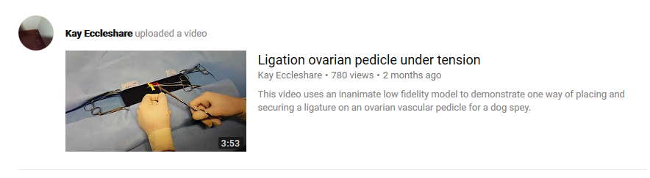
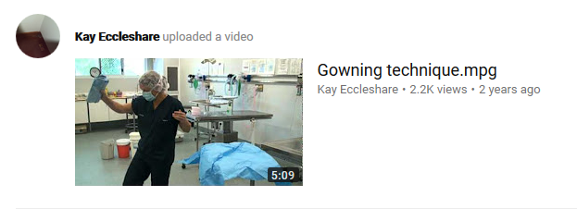
Development of videos to support each skill or model

Slide 18
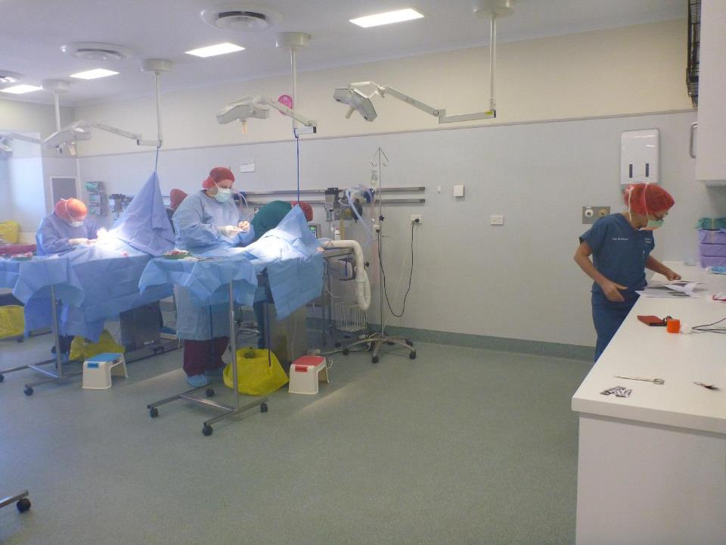

Slide 19

How have I used the 2016 Sessional Staff Teaching Award

Slide 20

…. leading to being asked to be on the committee of the inaugural VEDU Symposium
“..sharing of innovations, ideas and best practice in teaching and learning in an open and friendly atmosphere.”

Slide 21
2017 Sessional Teaching Award Winners

Slide 22
College of Healthcare Sciences
Helen Mason
Awarded for Exemplary commitment to development, delivery, management and assessment of undergraduate psychology
College of Medicine and Dentistry
Timothy Winstanley
Awarded for outstanding clinical supervision and support for final year Bachelor of Dental Surgery students on placement

Slide 23
Engela (Ronel) Bornman
Awarded for exemplary coordination of clinical experiences in Mackay, Proserpine and Bowen and clinical teaching of final year dental students
Dr Jason Diau
Awarded for establishing an international placement system that supports final year students’ clinical training in the Solomon Islands

Slide 24
Jodie Maxfield
Lecturer
College of Business, Law and Governance
Notes:
This is an alternative title page with space for images.

Slide 25


Citation:
A brave new world in Accounting: Changing curriculum design to support learning outcomes and improve student retention in first year accounting

Slide 26
Background:
BX2011 Accounting Principles and Systems
Offered – SP2
BBus – OP 17
Class cohort – FiF 59%, LSES 24%
Class structure – 2 hour lecture, 1 hour workshop and 1 hour tutorial
Assessment – 2 online quizzes 10%, mid semester test 20%, assignment 15%, Exam 55%

Slide 27

2013 – Bachelor of Business offered online
2012 – 44% of the class failed

Slide 28

Students complete tutorial work/assessment and can revise videos to reinforce knowledge
Students watched pre-recorded lecture videos
Work through practical problems in class, as a whole class and in small groups

Slide 29
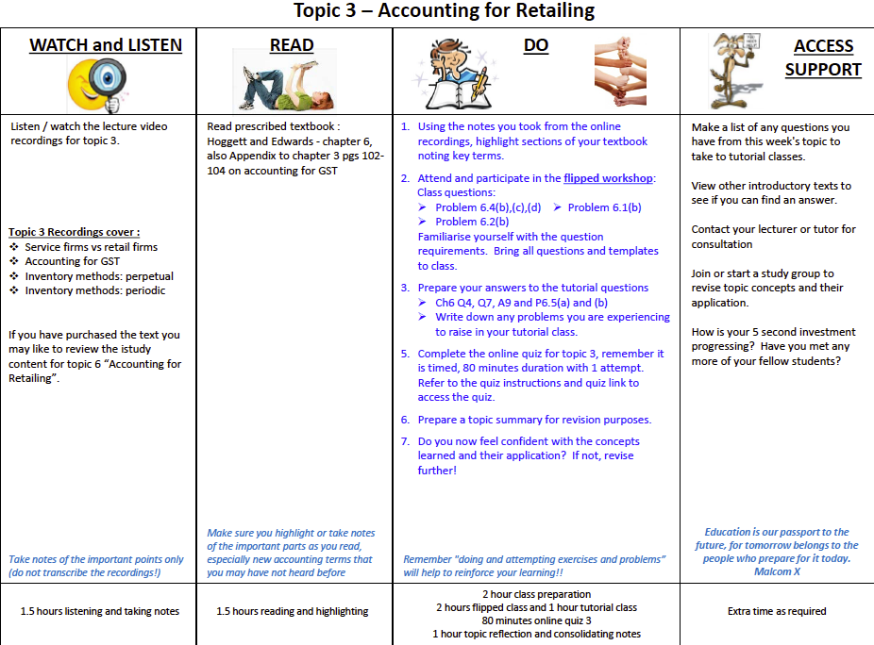
Orientating students to requirements: Study Plan

Slide 30
2015 – Feedback:
PRoT and Student Focus Groups
2015: high failure rate – 47%, also an unusually high failure rate across all first year subjects
PRoT of online site and student focus groups
  Development of Road Map / Trip Sheet and restructure of LearnJCU site

Slide 31
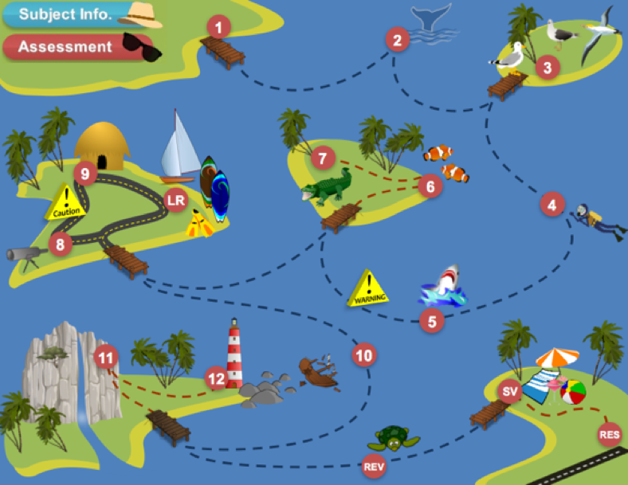




Slide 32
2015 – Feedback:
PRoT and Student Focus Groups
2015: high failure rate – 47%, also an unusually high failure rate across all first year subjects
PRoT of online site and student focus groups
  Development of Road Map / Trip Sheet and restructure of LearnJCU site
  In-video quizzing
  Implement formal weekly assessment quizzes

Slide 33
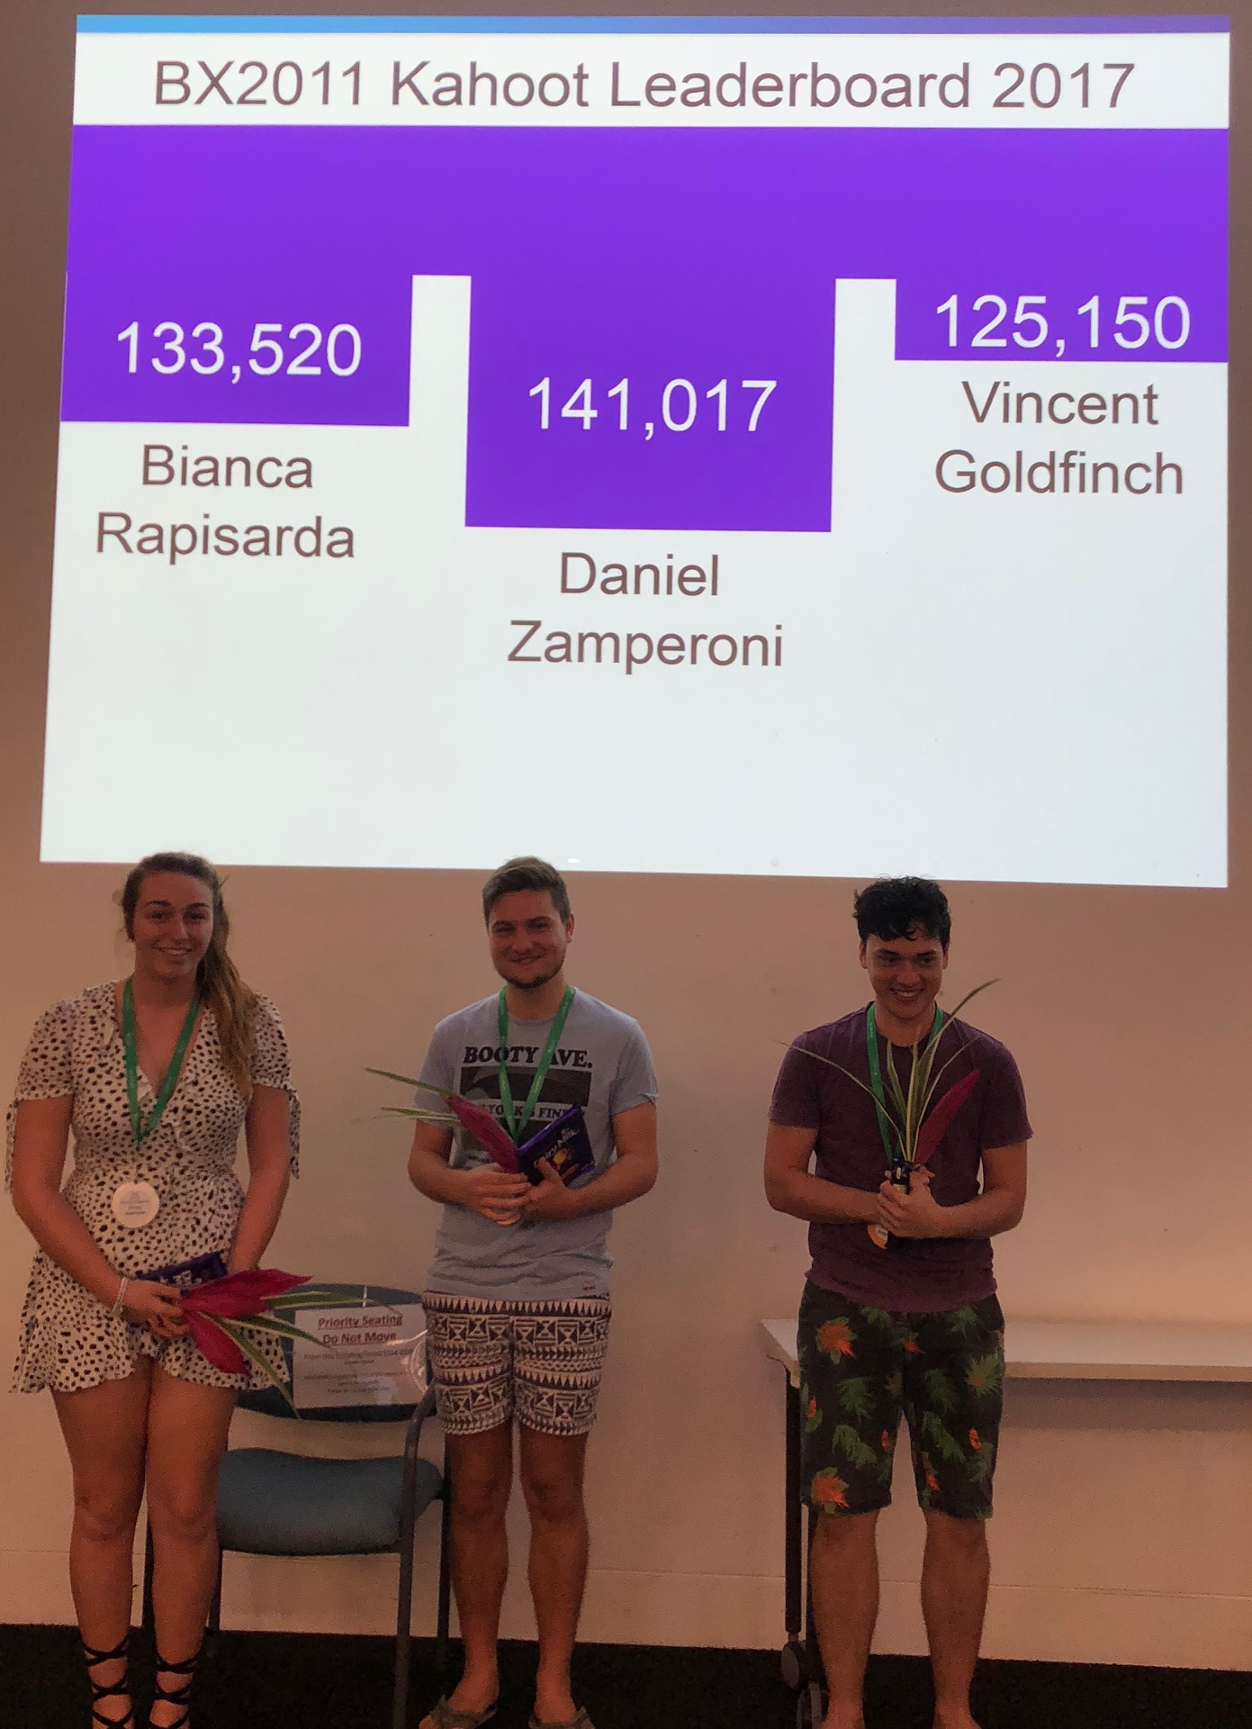
Increasing Active Learning (Engagement)
and Participation
Topic Video Lectures (pre-learning)
Containing in-video quizzes
Flipped Workshop
Kahoot (Quiz on Pre-Learning)
Engaging Activities
Weekly Online
Assessment Quiz
Tutorial Class

Slide 34

2016 and 2017
Change in Assessment
Weekly online quizzes 20%
Assignment 30%
Final Exam 50%
Engage
Revise

Slide 35
Subject Results:

Slide 36
2017 Sessional Teaching Award Winners

Slide 37
College of Business, Law and Governance
Melinda Kingsun
Awarded for promoting participation in and passion for ICT higher education and pathways
Salome Pretorius
Awarded for impacting student engagement and learning across a range of undergraduate law subjects
Simon Walker
Awarded for providing technology-enabled and community-connected learning experiences, and rich feedback and assessment support opportunities in law

Slide 38
College of Healthcare Sciences
Rebekah Boynton
Awarded for development of exemplary tutorial and subject materials in undergraduate psychology
College of Medicine and Dentistry
Helen Barnes
Awarded for provision of specialist compounding experience and exemplary service to the Bachelor of Pharmacy

Slide 39
College of Public Health, Medical and Vet Sciences
Karina Jones
Awarded for inspiring student learning by being a passionate demonstrator for veterinary anatomy practical‘s
Amy Smith
Awarded for exemplary contribution to student learning in health professional research methods through deep knowledge and teaching repertoire

Slide 40
Professor Chris Cocklin
Senior Deputy Vice Chancellor
James Cook University

Slide 41
Celebrating Sessional Staff at JCU
2017 Sessional Teaching Award Ceremony

