Slide 1
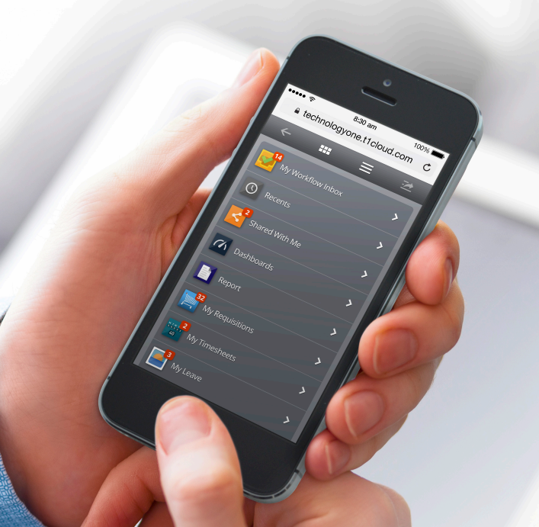
Procure to Pay
CIAnywhere

Slide 2
About Procure to Pay Group (P2P)
  Consist of 4 teams:
  Procurement
  Accounts Payable
  Corporate Card & Expense
  Travel
  Supported by:
  Strategic Procurement Group (SPG), including category management
  JCU Stores
  Corporate Procurement Plan, and Queensland Government Procurement Policy

Slide 3

Purpose and Scope
The JCU Procurement Procedures FMPM 711:
  Set the minimum standards required when conducting any procurement activity on behalf of JCU;
  Align with and support;
          JCU’s Procurement Policy FMPM 710; and
          Queensland Procurement Policy 2021
  These business rules apply to:
  All expenditure by JCU, regardless of funding source, unless specifically excluded by the policy (includes all staff, students, contractors etc)

Slide 4

Determining the Appropriate Procurement Approach
Monetary Caps
Procurement monetary caps are provided to ensure that a fair, equitable and transparent competitive market engagement process is maintained. For simplicity, the monetary caps have been defined within four value ranges as follows (GST EXCLUSIVE):
>$0 - <$10,000 - In-formal quotes (can include emails, screenshots, written quotes)
>$10,000 - <$50,000 - 2 Written quotes required
>$50,000 - <$200,000 - 3 Written quotes required
>$200,000 - Request for tender through Strategic Procurement Group
Note:
All Consultants must be engaged through the P2P Group irrespective of value;
Treatment of risk should also determine the most appropriate procurement method (high risk service order may require a contract).

Slide 5
Purchase Requisition & Contracts
Where a legally binding contract exists between JCU and a Supplier/s, it is the responsibility of the purchaser to ensure the contracted supplier is utilised. Purchases conducted outside of established corporate contracts may be deemed to be a breach of contract and for which JCU may be liable.
For example, all travel arrangements for JCU travel must be arranged through the JCU travel providers and the CONCUR system.
Note: If unsure contact the P2P Group for advice.

Slide 6

Procurement of Consultants & Professional Services
There are rules for the Engagement of Consultants & Professional Service Contractors outlined by the ATO, Fair Work Legislation, and other legal bodies.
The P2P Group must be utilised for all engagements of Consultants. (Refer FMPM 711 for the definition of Consultants).
A Consultant must not commence providing services to JCU without execution of specific contract documents or purchase order by the P2P Group.
It is very important that this requirement is observed, as it enables JCU to properly manage its commercial and legal risk.
The implication of incorrectly defining a contractor/consultant relationship is that the ATO and Office of State Revenue may impose penalties, interest and administration charges on unpaid superannuation and payroll tax (including personal fines up to $54,000).
For all engagements less than $10,000 P2P will determine if a
Contract is to be established or if a Purchase Order will suffice.

Slide 7

Purchase Requisition Approvals
All expenditure to be incurred on behalf of JCU, whether for capital or operational expenditure, must be approved PRIOR to any commitment being made with a supplier.
Expenditure must be approved by a staff member with the relevant financial delegation authority, refer to the Financial Delegations Register
A Purchase Requisition must include the total of the intended commitment to the supplier (including multiple years of a contract), and must NOT be split across a number of Requisitions for the purpose of bypassing appropriate financial delegation approval levels.

Slide 8


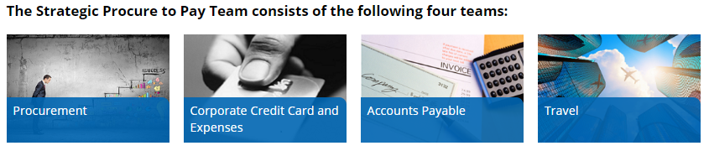
Procurement Contact
Refer to the website
ServiceNow Knowledge base
Send query through ServiceNow
Email procurement
  procurement@jcu.edu.au
Call one of the team
  Contact details are on the website

Slide 9

What is CIAnywhere, and How do I access it?
It links directly to the university store and product catalogues reducing the need for quotes (some exclusions apply);
It automatically directs approval workflows to the appropriate delegate/s; and
It facilitates the use of valid suppliers
Staff without CIAnywhere access, log a finance request in Service Now to request access (if required)
Google Chrome is the preferred browser, Can be used anywhere and on any device – laptop, smartphone, tablet or PC (When off campus access via VPN)
Do I have access to CIAnywhere?
Is the supplier already in the system? - If not, can I use an alternative supplier?
Do I have the required quotes/documentation/approved exemption from quote?
Do I have available funds and approval?

Slide 10
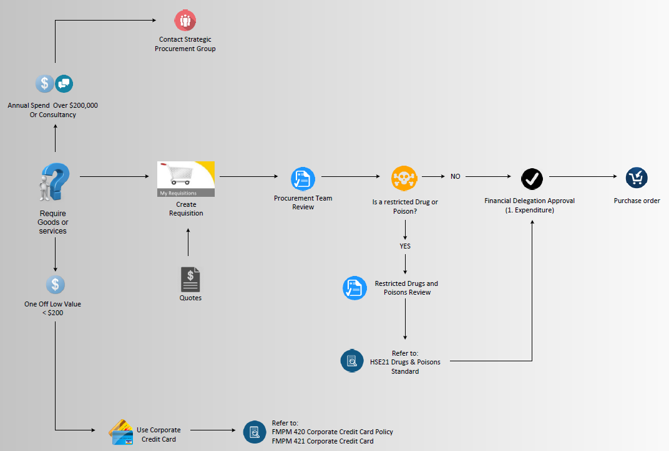


Slide 11


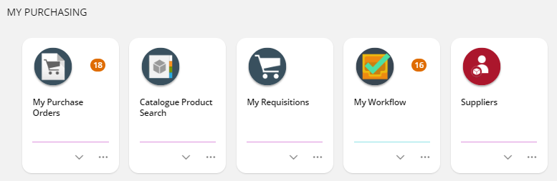
CIAnywhere – Staff Homepage
https://www.jcu.edu.au/staff Click on ‘My Requisitions’
Example on Screen

Slide 12

Requisition – SUMMARY
SETTINGS PAGE
Comments –information appears on the PO print (minimal characters apply) - Quote numbers
Date required – date all goods/services will be delivered/completed.
PO Type – standard (blanket orders to be discussed with Procurement team first)
Always raise requisition as ‘GST Inclusive’
End user details – need full name, phone number and email
REQUESTED ITEMS – item descriptions should match quote
Supplier – must be active, check supplier details (ONLY search by ABNs)
Description – as to appear in Finance One (40 characters, does not appear on PO)
Long Description – appears on PO, include SKU, full descriptions, event/service dates
Goods/Service – freight is a service and must be a separate requested line
Quantity – quantity must be correct (do not tally up the total goods as 1 with $ value)
Value – Cost must be the GST inclusive value
Date – date of expected delivery/Completion of Service (can be different each line)
Delivery Point – cannot split delivery points in the one PO
Assets, Contracts, Restricted Products – Discuss with Procurement staff
Cost Account – check ledger (2021 expenditure etc), account number, use code
ATTACHMENTS must be relevant to PO (quotes, screenshots, emails, etc)

Slide 13
Goods Receipting/Invoice Approval
All orders will be ‘goods receipted’ by AP when Tax invoice is received
  Invoices under $10k excl will be receipted/matched automatically (same as current process).
  Invoices over $10k excl will be systematically pushed to PO owner (Requisitioner) to ‘ok’ invoice for payment (replaces manual emails from AP currently).
  You will simply need to ‘accept & approve’ the goods receipt AP have done in CIAnywhere (or from email notification). If you believe the goods receipt/invoice match is incorrect, you can decline etc – Example email on screen.

Slide 14

Purchase Order Amendments
PO amendments will be done through CIAnywhere by the PO owner (Requisitioner). There will be no further need to raise a ServiceNow request (this form will be removed from Service Now).
Procurement review the PO amendments, and system will workflow to appropriate approver based on the financial delegation policy. No need for prior manual approval.
Examples on screen

Slide 15
Delegation of Duties – NOT Financial Delegation
When going on extended leave, you can now delegate access to your orders to another staff member, to cover in your absence.
As you are the PO Owner (requisitioner), no other staff member can submit order amendments, or approve invoices (goods receipts over $10k), on your behalf unless you permit them access.
We would recommend delegating your access to someone in either a similar role, or discuss with your admin team members (delegates must also have access to CIAnywhere).
Delegation requested through Service Now
Example on screen

Slide 16


Questions or Comments?

