Slide 1





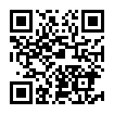
Study planning
Assessment Planning
Online resources
Shortcourses
Studiosity
PASS
Peer Advice Desk
Learning Advisors

