Slide 1
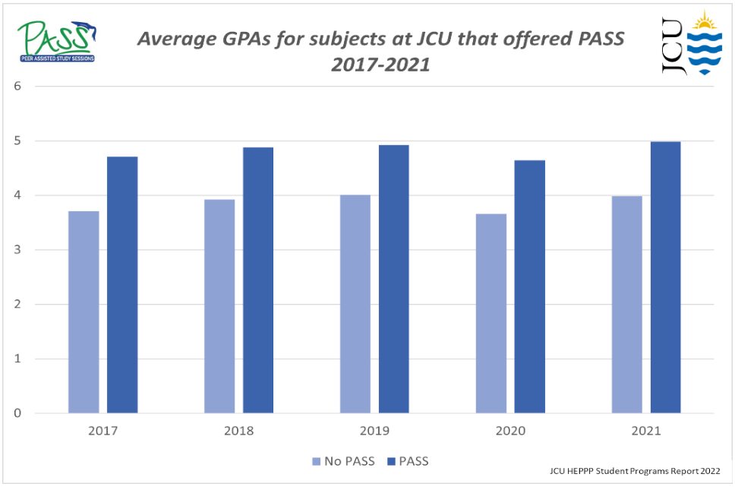
Peer Assisted Study Sessions
FREE academic support program
Study with a senior peer leader (who has taken your subject in the past)
Work together to better understand the content and learning objectives for a subject
Improve marks and overall academic performance
PASS generally commences in Week 2

