Slide 1
JCU Laboratory Induction Template
Work Health and Safety (20-1)

Slide 2
Add Title
Add detail about the specific laboratory

Slide 3
Risk Management Plan
Identify the specific risks within this laboratory and communicate the risk assessment/management plan

Slide 4
General Laboratory Requirements
The following rules apply as a minimum to all laboratories:
Unauthorised entry to the laboratory is strictly forbidden
No food or drink for human consumption is to enter, or to be consumed within a laboratory
Staff and all students (undergraduate, honours and postgraduates) must obtain permission to access the laboratory out of hours
Laboratory waste must be disposed of correctly and not flushed to sewage
Enclosed footwear must be worn
Personal protective equipment is to be worn as specified
Safety glasses to be worn when handling hazardous substances

Slide 5
General Laboratory Requirements (cont)
Long / mid length hair and scarves shall be tied back
Loose clothing secured and jewellery removed when using equipment with moving parts
Children are not permitted in laboratories
When leaving microbiological laboratories remove laboratory coats and wash hands
Mouth pipetting is prohibited
Experiments which will be left running overnight must have an “unattended experiment card” filled in specifying contact details of researcher, hazards and steps to be taken in an emergency. The experiment must be appropriately secured/isolated for the time period
Do not use any machines, equipment or laboratory apparatus without prior instruction / training by the supervisor or technical staff on Safe Operating Procedures (SOP) and practices. Whilst using any equipment the relevant SOP shall be adhered to
Unless required, windows both internally and externally to the building are not to be covered.

Slide 6
Entry Signage
Each laboratory has entry signage to identify the laboratory contacts and emergency information

Slide 7
PPE Microbiological
Rear fastening laboratory gowns are to be worn when inside the laboratory and removed before exiting
Hands are to be thoroughly washed before exiting the laboratory (after taking off laboratory gown)

Slide 8
PPE Chemical
Front or rear fastening laboratory gowns are to be worn when inside the laboratory and removed before exiting
The use of eye and face protection is specific to the laboratory and tasks being conducted
Enclosed foot wear is to be worn at all times.

Slide 9
Vaccinations
Insert laboratory specific requirements

Slide 10
After Hours and Working Alone
Any work in laboratories that is to be conducted outside of normal working hours that is considered to pose a risk to health and safety, will require a risk assessment and approval from the Laboratory Supervisor or Academic Supervisor. There must be suitable control measures in place to reduce the risk to an acceptable level
Insert laboratory specific rules.

Slide 11
Decontamination Certificate
Equipment and items within a laboratory will require decontamination before being removed from the laboratory or maintenance is carried out
The JCU Decontamination Certificate is to be attached to the equipment or item once decontamination has been carried out by service personnel.

Slide 12
Institutional Biosafety Committee (IBC)
JCU is an Accredited Organisation certified by the Office of the Gene Technology Regulator (OGTR). The University is required to have an IBC in place.
The IBC oversees compliance of JCU with the OGTR and makes recommendations relating to Biosafety Issues at JCU. Hazards the IBC specifically monitor include:
Genetically Modified Organisms
Materials derived from human sources
Materials derived from animal sources in particular those with zoonotic infection
Micro–organisms.

Slide 13
Biosafety Applications
Biosafety at JCU is managed under the WHS-PRO-009 Biosafety Procedure. The documents can be found at: https://www.jcu.edu.au/policy.
A biosafety application is required for projects with biological hazards. Hazards include, but are not limited to:
GMO:
  Genetically modified microorganisms
  Genetically modified animals and plants.
Materials derived from human source:
  Collecting blood
  Interacting with potentially infected individuals, for example, interviewing or taking biological samples
  Activities conducted outside of facilities being operated under infection and control requirements from Queensland Health
Materials derived from animal sources, in particular those with potential for causing zoonotic infection and:
  Dealing with wild animals, such as bats (e.g. Lyssavirus)
  Dealing with domestic animals such as horses (e.g. Hendra Virus)
  Dealing with animals outside of Australia (e.g. rabies)
Purposely infecting animals
Working with poisonous or venomous organisms
Synthetic toxins/biologicals
Working with microorganisms.
Risk Assessment
Research, teaching or operational work with Biohazards should only be undertaken when a risk assessment has been developed and the relevant controls implemented. A risk assessment is to be completed in RiskWare.

Slide 14
Biosafety (cont)
If there is uncertainty whether a project requires a biosafety application, the applicant should seek guidance by sending an email to biosafety@jcu.edu.au.
The email should include the following information:
applicants name
contact details
name of supervisor
Division
College/Institute
Description of the project.
During the process the Divisional Biosafety Representative may be able to offer assistance.
An initial ruling will be made by an IBC member to determine one of the following for the project:
Confirm that the biosafety application process is relevant, and the full biosafety application is to be completed; or
That the biosafety application process is not relevant, and the decision will be recorded on a central register maintained on the Biosafety Drive; or
Further information is required to make the assessment.
Biosafety Applications can be sent to biosafety@jcu.edu.au.
Biosafety Training
Any person working with biological material in a PC facility and in the field must complete and pass the Biosafety training that is available on Learn JCU.
A laboratory induction is required to be completed by anyone working within a physical containment facility or laboratory.
Adequate training and instruction may also be required prior to the operation of any specific piece of equipment.

Slide 15
Biological Spill
Advise others in the vicinity
Allow the spill to settle to avoid aerosols
Use biological spill kits
Use PPE, respirator, gloves and gown
Follow the documented cleaning process for the laboratory (eg absorb with material, then spray with 70% ethanol)
Autoclave waste
Make an entry in Riskware.

Slide 16
Biosafety Cabinets
Biosafety cabinets are used specifically for biological hazards; these cabinets are not the same as chemical fume cabinets. Chemical fume cabinets shall not be used when working with infectious materials
Anyone using a biosafety cabinet is to be trained in the operating procedures including decontamination procedures
Any procedure that produces aerosols should be performed in a biosafety cabinet
Biosafety cabinets are to be inspected and tested against the relevant Australian Standard for the class of cabinet before the first use and then annually
The test date is to be displayed on the cabinet.

Slide 17
Transporting Biologicals

Slide 18
Quarantine
Quarantine requirements are monitored by the Department of Agriculture and Water Resources in accordance with the Queensland Biosecurity Act 2014.
The Department issues permits for importation and monitors compliance through auditing of Quarantine Approved Premises (QAP).
Import permits impose the requirements relating to the specific application. The requirements of a permit must be met in full.
Import permit requirements can range from:
Initial inspection at the point of entry (in some cases there are no further requirements)
Import with post entry requirements including the need to use material within a Quarantine Approved Arrangement (QAA), track usage and disposal.

Slide 19
Quarantine (Cont)
Biosecurity Import Conditions:
The Department of Agriculture and Water Resources has a Biosecurity Import Conditions (BICON) system for importing.
James Cook University has set up a multi-user BICON account administered by the WHS Unit.
Anyone planning on submitting import permit applications will need to register as a ‘user’ on the system. There are two ways to become a ‘user’:
Receiving an invite from the system administrator. Initially you would request an account from importpermit@jcu.edu.au
When applying in the BICON system selecting the ‘account type’ as joining an existing ‘multi-user account’, and selecting James Cook University.
Once you have a user account, applications can be submitted to the Department of Agriculture and Water Resources.
Permit applications can either be paid by credit card or a tax invoice can be generated from the system. Be aware that when an invoice is generated the assessment process will not start until after the invoice is paid.
Any permits in the previous ICON system will not convert over to BICON, and will eventually expire under the old system.
Further information can be found at the following link: “http://www.agriculture.gov.au/import/bicon”.

Slide 20
Drugs & Poisons
Drugs and Poisons at JCU are managed under the WHS-PRO-011 Drugs and Poisons Procedure. The documents can be found at: https://www.jcu.edu.au/policy.
The schedule (S1- S9) assigned to a substance can be found on the Safety Data sheet.
S2, S3, and S4 can be authorised by the JCU Officer Delegated the Vice-Chancellor's Authority. Provided the requirements under the procedure are met. Non staff or faculty such as students require a Qld Health Approval to use S4 drugs unsupervised. Processing of Qld Health Approvals can take up to six weeks from the date received by Qld Health
S7, S8 and S9 substances can be authorised by the JCU Drugs Officers where the person requesting is a registered professional (doctor, veterinarian), or has an approval from Qld Health to use, store and obtain the particular substance. Processing of Qld Health approvals can take up to six weeks from the date received by Qld Health
The WHS Biological, Radiation and Chemicals Safety Advisor is to be advised where S4, S7, S8 and S9 substances are being obtained and stored. A central register of Qld Health Approvals and storage locations is maintained by the WHS Unit.
Storages of S4 and S8 substances will be audited by the Divisional JCU Officers Delegated the Vice Chancellor’s Authority on an annual basis.
The WHS Biological, Radiation and Chemicals Safety Advisor can be contacted for assistance.

Slide 21
Ionising Radiation
Ionising Radiation at JCU is managed under the WHS-PRO-014 Ionising Radiation Procedure. The documents can be found at: https://www.jcu.edu.au/policy.
The use of radiation sources and apparatus is highly regulated. To use a source or apparatus the following must be in place:
Possession Licensee
Radiation Safety Officer
Radiation Safety Plan
Approval to Acquire
Certification Inspection of facility/apparatus
User training
Monitoring
Prior to applying for a research project that involves radiation apparatus or sources, the applicant must receive in concept, approval from the relevant RSO and College Manager or Dean. This is to indicate that, if approved, the project will be supported.
Once the project approval is received, the required steps to use the source or apparatus must be put in place.
Projects will broadly fit two categories:
There is an existing isotope or apparatus in use and this is already documented in a Radiation Safety Plan. This will involve minor changes to allow use
There is no existing use of an isotope or apparatus, and there is no documented Radiation Safety Plan, RSO, or involving a reasonable investment of time and money to progress. The application aspects could take 180 days to be processed as the various components are submitted to the regulator.
The WHS Biological, Radiation and Chemicals Safety Advisor can be contacted for assistance.

Slide 22
Hazardous Chemicals
Hazardous Chemicals including carcinogens at JCU are managed under the WHS-PRO-010 Hazardous Chemicals Procedure. The documents can be found at: https://www.jcu.edu.au/policy.
The SDS for a substance can be used to determine if the substance is a hazardous substance, dangerous good or carcinogen.
Where there are Hazardous Chemicals the following must be in place:
Labelling
SDS available (typically through ChemWatch)
Risk Assessment
Appropriate storage.
The substance must be recorded on the ChemWatch inventory for the storage location. The WHS Biological, Radiation and Chemicals Safety Advisor can be contacted to provide a user account.
Schedule 10 of the Work Health & Safety Regulation 2011 (Qld) lists chemicals that are Schedule 10 Prohibited or Restricted Carcinogens. To possess and use these substances an application for authorisation to use, handle or store the substance must be submitted to and approved by Workplace Health and Safety Queensland. The applications can take several months to process.
The WHS Biological, Radiation and Chemicals Safety Advisor can be contacted for assistance.

Slide 23
Chemical Spills
When an uncontrolled chemical spill occurs, the following process must be followed:
Identify the chemical type and refer to the Safety Data Sheet (SDS) for personal protective measures and for specific clean-up method
Access the spill kit and don the required PPE / respiratory protection if required
Contain the chemical spill.
Spill kits are to be:
Appropriate for the substances within the laboratory
Inspected and maintained as part of laboratory inspections.

Slide 24
Gas Cylinders
The use of gas cylinders must have a risk assessment performed by the laboratory supervisor or person proposing to use the gas cylinders. The following risks must be considered depending on the content of the gas cylinder and intended location of the cylinder. Including but not limited to:
Potential for asphyxiation
Potential for toxic effects
Potential for fire
Potential for increased oxygen
Mounting to avoid physical damage
Controls for safe relocation of gas cylinders to avoid harm caused by manual handling or release of contents
Insert laboratory specific detail.

Slide 25
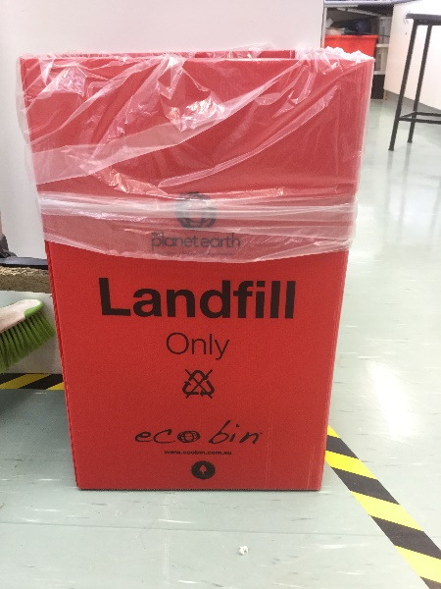
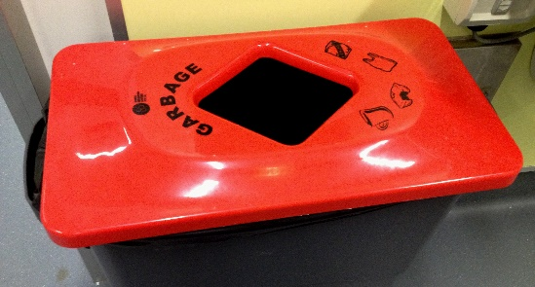
General Waste Bin
General waste bins can be used for:
Paper
Cardboard
Plastic wrap
Clean plastic products
Rinsed chemical bottles without labels
Well contained & clearly labelled non hazardous laboratory waste (eg gloves).

Slide 26
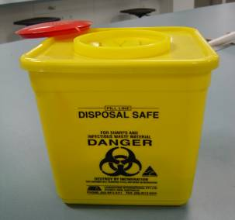
Sharps & Pipettes
Sharps are anything capable of puncturing your skin, eg. scalpel blades, needles - dispose of in a yellow “Sharps” container
Place full containers into a “Clinical Waste” bin for disposal
Pipettes can cause rubbish bags to tear. As such pipettes are to be placed into a container with hard sides before being placed into rubbish.

Slide 27
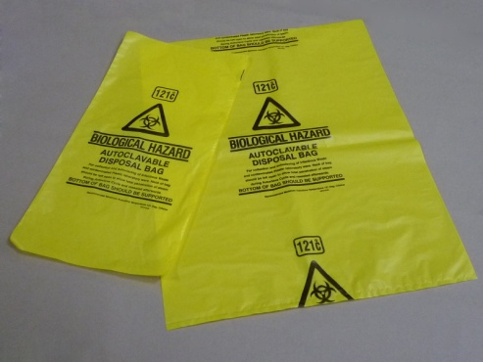
Clinical Waste
Any waste:
  From human origin (eg. blood, tissue)
  Genetically modified organisms
  Animal waste that has potential to be infectious to humans
  Any items such as pipettes, gloves, absorbent materials that have been in contact with any of the above clinical waste categories
This waste must be placed into a “biohazard” waste bag and disposed of into a “Clinical” waste bin.

Slide 28
Pharmaceutical and Cytotoxic Waste
Scheduled drugs and poisons are pharmaceutical waste, including antibiotics
Pharmaceutical waste is to be disposed of in a “pharmaceutical waste” bin
Pharmaceutical waste can be placed into a “Cytotoxic waste” bin
Cytotoxic waste is to be disposed of in a “Cytotoxic waste” bin.

Slide 29
Chemical Waste
Label chemical waste
Do not mix chemical waste
Do not accumulate large volumes of waste
Dispose of waste though a regulated waste disposal company
Contact <INSERT NAME> for disposal of waste from this laboratory.

Slide 30
Fume Cabinet
Excess materials should not remain in fume cupboards
Fume cupboards shall not be used as storage facilities for hazardous materials
When an experiment is completed, the equipment is to be cleaned and the cupboard left clear for the next experiment
Large volumes of substances are not to be placed into the fume cupboard with the intent of allowing the substance to evaporate
Fume cupboards are to be inspected at least annually in accordance with the requirements of AS/NZS 2243.8. The annual inspection regime is coordinated by the Estate Directorate.

Slide 31
Equipment in the Laboratory
Detail specific laboratory procedures and rules

